Slide 1
SMA & HULL TRADING WEEK 4 PRESENTATION
Master of Science in Financial Engineering

Slide 2
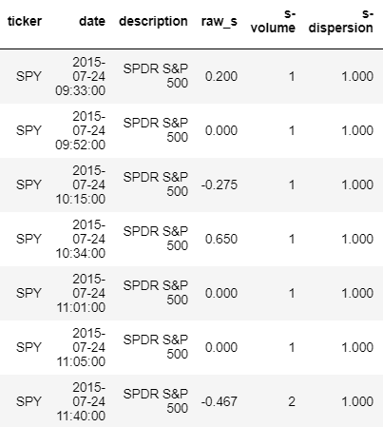

Factors and their definitions Activity Feed
Raw-S : UNWEIGHTED sentiment estimate for ONE minute
S-Volume : Tweet volume for ONE minute for the corresponding Raw-S
S-Dispersion : Measure of tweet source diversity for ONE minute

Slide 3

15-Min Feed
Root Factors :
Raw-S : UNWEIGHTED sentiment estimate for 24 hours rolling period
S-Volume : Tweet volume for 24 hours rolling period for the corresponding Raw-S
S-Dispersion : Measure of tweet source diversity for 24 hours rolling period
𝑆𝐷𝑖𝑠𝑝𝑒𝑟𝑠𝑖𝑜𝑛 = # 𝑈𝑛𝑖𝑞𝑢𝑒 𝐴𝑐𝑐𝑜𝑢𝑛𝑡𝑠 / 𝑆𝑉𝑜𝑙𝑢𝑚𝑒
S : EXPONENTIALLY WEIGHTED sentiment estimate for 24 hours rolling period
Derived factors:
S-Score : Normalized Raw-S
SV-Score : Normalized S-Volume
S-Buzz : A measure of unusual volume activity compared to a universe of stocks
S- Delta : Change in S-Score over a 15 minute look back period
1

Slide 4
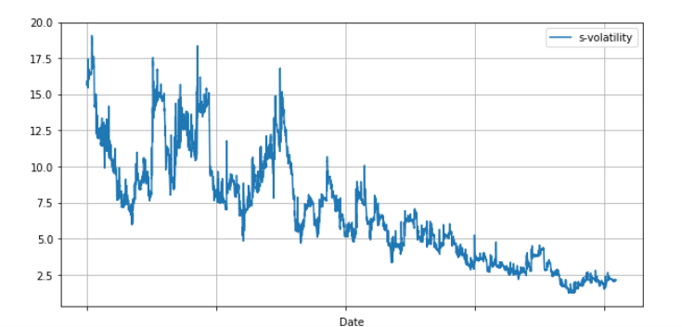
Stationarity (ADF Testing)
Activity Feed
Raw-S | Stationary
S-Volume | Stationary
S-Dispersion | Stationary
15-Min Feed
Raw-S | Stationary
Raw-Score | Stationary
S | Stationary
S-Volume | Stationary
S-Volatility | Not Stationary
S-Score | Stationary
SV-Score | Stationary
SV-Volatility | Stationary
S-Dispersion | Stationary
S-Buzz | Stationary
S-Delta | Stationary

Slide 5
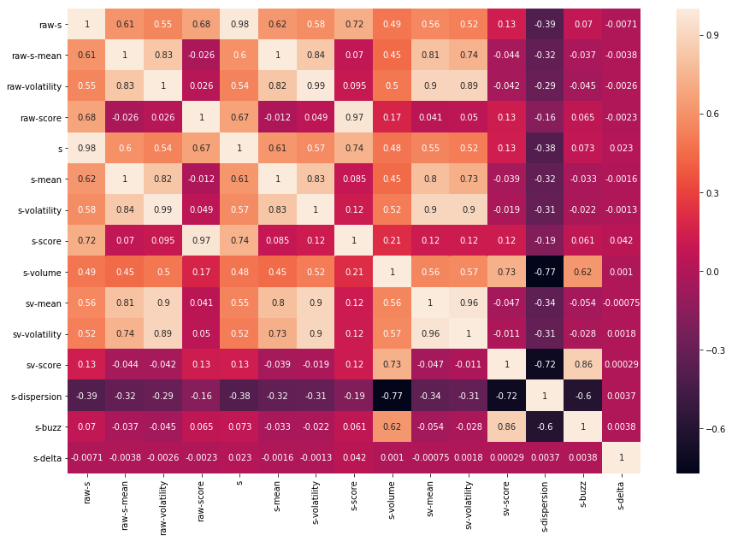

Correlation of all factors for 15-Minute feed

Slide 6
Application of Social Media Signals to Enhance Index Performance
Overview
Sentiment Analyzed Model vs S&P500
Methodology to calculate weights:
Score(Monthly) = 0.5 * S_Score(Monthly) + 0.5 * SV_Score(Monthly)
Performance:
The sentiment analyzed model gave a 1.5% higher return than the base model

Slide 7
Data Aggregation for Activity Feed
For 2015, 2016, 2017
Eliminated weekends
Filtered for trading hours
Calculated 20 minute rolling Exponentially Weighted MA
Filtered the pre-close sentiment
319111 → 615

Slide 8
Data Aggregation for 15-Minute Data Feed
For 2015, 2016, 2017
Eliminated weekends
Filtered the pre-close S-Score
81821 → 615

Slide 9
Binary Classification
If Returns < 0 :
Label = -1
If Returns == 0 :
Label = 0 (Never)
If Returns > 0 :
Label = 1

Slide 10
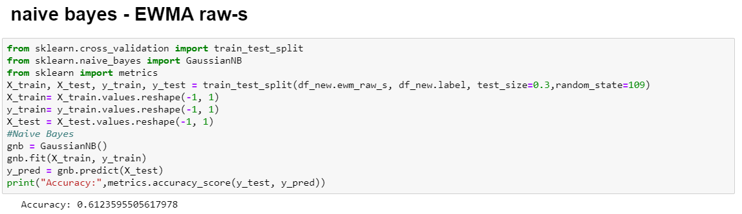
Activity Feed

Slide 11
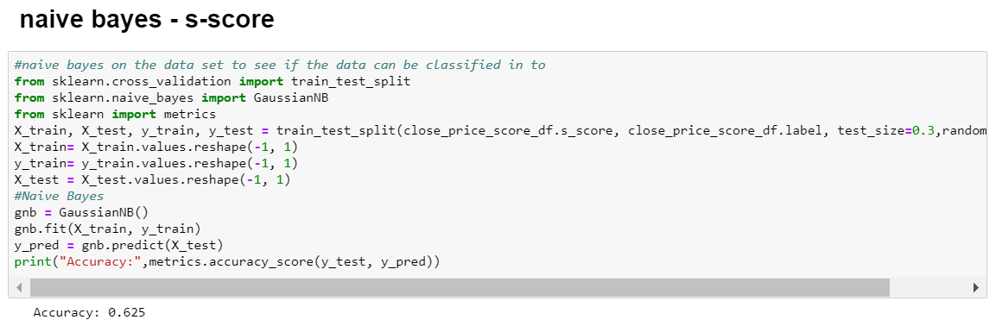
15- Minute Feed

Slide 12
THANK-YOU!

